Slide 1
Should Higher Education Be Free?
Michael Otsuka
LSE

Slide 2
Who Should Pay for Higher Education?

Slide 3
1st Answer: General taxation
H.E. should be paid out of general taxation
  Students don't foot the bill
  Analogy to schools and hospitals
Aka 'free' H.E.
  But 'Free is just another word for "someone else pays"' (Barr)

Slide 4
2nd Answer: Direct beneficiary pays
Students pay for their own H.E.
School leavers haven't got much income or wealth
  But they can pay via student loan repaid out of the future stream of income their education will generate
Analogy to a mortgage
  Loan for a home paid out of one's future stream of income

Slide 5
Gap year thought experiment
Half intend to take up a job immediately upon leaving school
The other half prefer a gap year involving:
  Immersion into languages and cultures of different peoples
  Contemplation of artistic and architectural splendours of past and present civilizations,
  Experience of the beauty and diversity of the natural world

Slide 6
Should a gap year be state-funded?
Petition to Parliament:
  "A gap year is a right, not a privilege!"
Answer:
  "Sorry, but the state would engage in unfair exploitative extraction if it coercively taxed the half of the population that has chosen to work in order to fund the worldwide travels of the other half. If you'd like to take a gap year, you'll have to find your own sources of funding."
Disanalogy between gap year subsidy and Unconditional Basic Income (UBI)
  Gap year subsidy is like UBI, but only for those who choose to take up surfing.

Slide 7
Against a principle of perfection
One can oppose a funded gap year without denying its high intrinsic worth
Even though a gap year is of high value
  the state should not tax some in order to enrich and perfect the lives of others
  i.e., rejection of a 'principle of perfection' that directs the state to 'maximize the achievement of human excellence in [such things as] art, science, and culture' (Rawls, TJ).

Slide 8
No perfectionist case for H.E. subsidy
State should act only for reasons that are publicly acceptable:
  those no reasonable people in a pluralistic society could reject.
All reasonable people can agree that murder and mayhem are wrong, illness, starvation, and poverty are bad, health is good,
  But reasonable people can disagree about the worth of cultural and material pursuits informed by different conceptions of the good life

Slide 9
Rawls against perfectionist subsidy
'…the principles of justice do not permit subsidizing universities and institutes, or opera and the theater, on the grounds that these institutions are intrinsically valuable, and that those who engage in them are to be supported even at some significant expense to others who do not receive compensating benefits. Taxation for these purposes can be justified only as promoting directly or indirectly the social conditions that secure the equal liberties and as advancing in an appropriate way the long-term interests of the least advantaged.' (Rawls, TJ, pp. 291-2, my emphasis)

Slide 10
Primary goods
The state should limit itself to the provision of what Rawls calls primary goods:
  things that people 'generally want in order to achieve their ends whatever they are'

Slide 11
Needs trump perfection
Raising taxes to spend on…
  better pre-school, primary, and secondary education, better health care and disability support, and shelter for the less well off.
…takes priority over spending on…
  fully covering cost of tuition and living expenses for H.E.

Slide 12
Even when needs don't compete…
…there's a case against forcing some to pay for the enrichment of the lives of others
Even if school leavers who work earn enough so they can well afford to subsidize others,
  it's an unjustified imposition to force them to fund the gap years of others.
We shouldn't expect others to foot the bill, however worthwhile and enriching the pursuits we would like them to subsidize.

Slide 13
Tax-funded H.E. is inegalitarian
The half of the population that goes to university is subsidized
  by the half that doesn't go to university,
  whose non-participation is explained by brute bad luck as well as choice, and
  who will earn less, on account of their lack of a university degree
    the effect on earnings over a lifetime 'of having a degree, relative to not having a degree, is [a] 28% [boost] for men (approximately £168 k) and [a] 53% [boost] for women (approximately £252 k) on average' (Walker and Shu, quoted in Colburn & Lazenby, p. 8)

Slide 14
Dworkin's hypothetical insurance
Fair conditions of choice:
  No knowledge of your talents and earning potential, or whether you will go to university
In such conditions, since
  you know that 'university graduates have on average higher incomes over a lifetime',
  and that this is not simply or primarily a matter of choice,
  you will choose that which 'does not improve the option of going to university at the expense of the option of not going to university'. (C&L, p. 10)
So you will reject tuition fee free education financed entirely out of general taxation
But you will also reject completely private funding of H.E.
Rather, you will choose state-subsidized loans

Slide 15
Case for loan subsidy: positive externalities
H.E. benefits society as well as the student:
  greater economic growth
  less expenditure on healthcare
  higher quality of democratic participation
  lower crime
These benefits will be undersupplied if H.E. is not subsidized but left solely to choices on the private market.

Slide 16
What kind of subsidy?
Ed Miliband's proposal
  Tuition fee lowered from £9,000 to £6,000, with a £3,000 state subsidy to the university
  Inefficient:
    High earners needlessly subsidized, because they would go to university even if charged the full £9,000 cost of their education
The current arrangement is more efficient:
  Those who become higher earners are charged full price, but
  Those who earn less are given rebates

Slide 17
Details of current subsidy of loans
Loan to cover £9,000 annual tuition (+ maintenance)
Repaid over 30 years at 9% of income above £21,000
  £21,000 = roughly the median income of UK taxpayer
Any portion of loan not repaid in 30 years is cancelled
But high earners pay full cost of their education
  A more efficient subsidy than a £6,000 tuition fee cap, since high earners aren't deterred by liability to pay full cost
£21k threshold and 30 year write off address fear of being burdened with too much debt if one is not a high earner
  Therefore designed so as not to deter university participation by those from poorer backgrounds

Slide 18
Assumption of rational chooser
Justification of the subsidy assumes:
  Information and capacity to rationally weigh expected risks and benefits of taking on debt for H.E.
Some doubt this assumption applies to school leavers
  especially from poorer backgrounds
Such doubt is paternalistic
The young won't rally around:
  "Make our higher education free because we cannot be trusted to assess its costs and benefits"

Slide 19
Egalitarian case for entirely tax-funded higher education
Abolition of tuition fee justified if and only if H.E. reformed along the following two lines:
  1. Money focussed on H.E. basics
    More like Germany (€13,665 per student compared with €16,500 in UK) than like US

Slide 20
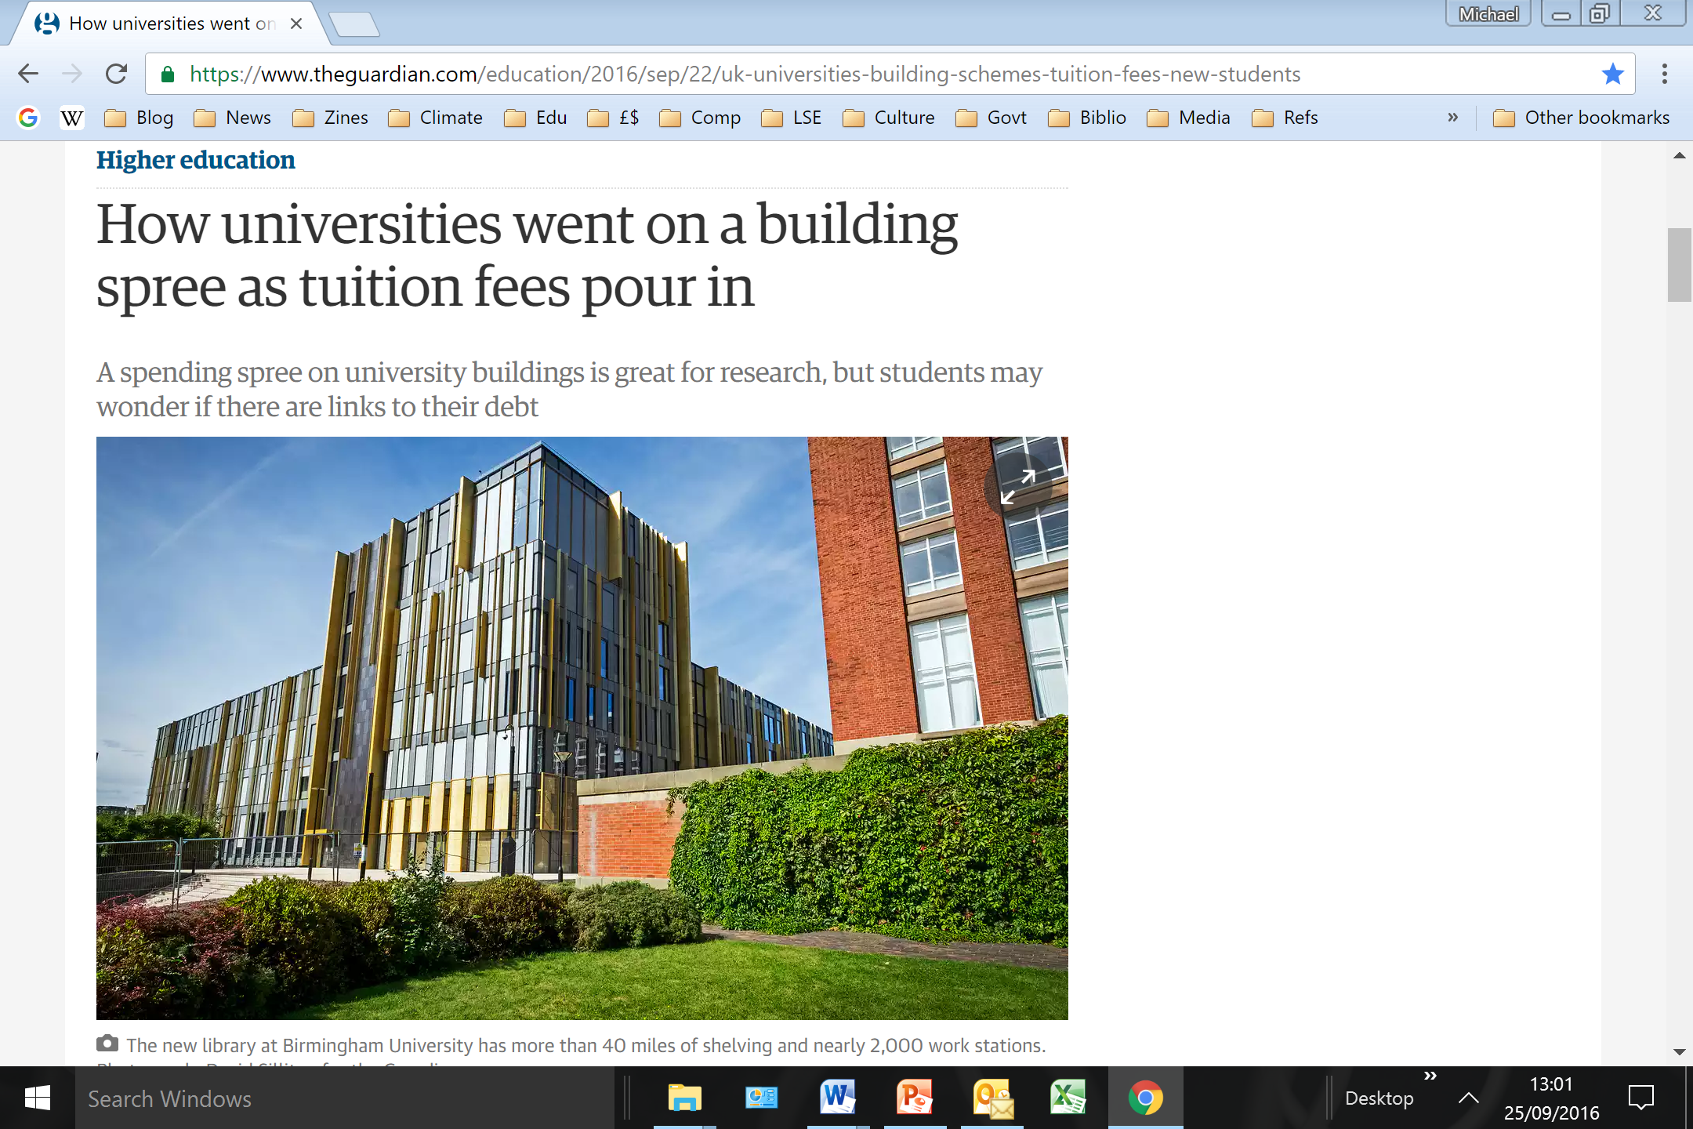

Slide 21
German v. US (& UK) universities
"German universities consist almost entirely of classroom buildings and libraries—no palatial gyms with rock walls and water parks…; no billion-dollar student unions with flat-screen TVs and first-run movie theaters. And forget the resort-style dormitories. What few dorms exist are minimalistic, to put it kindly—but that’s largely irrelevant anyway, as many German students [around 90%] still live at home with their parents, or in independent apartment shares…. It's quite common for German students simply to commute in for class, then leave."

Slide 22
Elite US and UK universities
"Modern universities serve as gateways to power and influence for the students who pass through their classrooms and lecture halls, and ... the level of funding that they receive—through student tuition, government provision, philanthropic support, etc.—is crucially connected to their role in sustaining objectionable social inequalities." (Wallace, View from Here, pp. 218-19)

Slide 23
Egalitarian case for entirely tax-funded higher education
Abolition of tuition fee justified if and only if H.E. reformed along the following two lines:
  2. Equal H.E. for all
    University system flatter
      less hierarchical with no selective elite group
    Vocational H.E. as good as academic universities
      German Fachhochschulen
    Universal availability of, and participation in, H.E.
In sum, UK H.E. should be modelled more along the lines of German H.E. and UK state secondary education

Slide 24
Hierarchy for the sake of knowledge?
Are 'world class universities' needed for research excellence?
Of the egalitarian university systems (Nordic, Lowlands, & German-speaking), only Switzerland has a university ranked in the top 30
But German non-teaching institutes such as the Max Plank Society outrank all European universities
Perhaps there should be more separation of research and teaching.

Slide 25
General lesson
One can't answer the question "Who should pay for H.E.?"….
…and there is no universal right to tuition fee free H.E.,
  irrespective of the manner in which H.E. is provided in the society in question.
If we retain the hierarchy, costliness, and exclusiveness of the UK status quo,
  then those who personally reap the greater share of its unequal benefits should make a greater contribution to its costs.

Slide 26
Bibliography
Ben Colburn and Hugh Lazenby, 'Hypothetical Insurance and Higher Education', Journal of Philosophy of Education (2015) online early
Michael Rustin, 'The neoliberal university and its alternatives', Soundings 63 (2016): 147-170
Nicholas Barr, 'Higher Education Funding', Oxford Review of Economic Policy 20 (2004): 264-283
Nicholas Barr, 'The Higher Education White Paper: The Good, the Bad, the Unspeakable', Social Policy and Administration 46 (2012): 483-508
Paul Bou-Habib, 'Who Should Pay for Higher Education?' Journal of Philosophy of Education 44 (2010): 479-495
Nick Hillman, 'Keeping up with the Germans: What can Germany teach the UK on fees, migration and research?' (HEPI Report 77)
Philip Oltermann, 'Germany axed tuition fees – but is it working out?' The Guardian (4 June 2016)
Rebecca Schumann, 'You Can Now Go to College in Germany for Free', Slate (October 10, 2014)
John Rawls, A Theory of Justice (Harvard University Press, 1971)

